Slide 1
EPQ – Artefact Server Controller
By James Rand

Slide 2
The main aim of the project
File server that is used to store work
Sever cannot always be on.
I always want to have access to the server.
Build a device that can remotely turn on and off the server.

Slide 3
Checklist
Be able to turn the server on and off
Be power efficient to avoid cost
Forward a shell to the server
Have an interface to perform all of the tasks above
Do not exceed the budget of £50.00

Slide 4
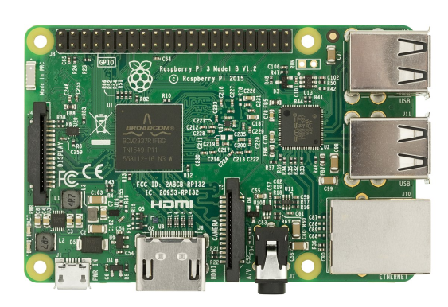
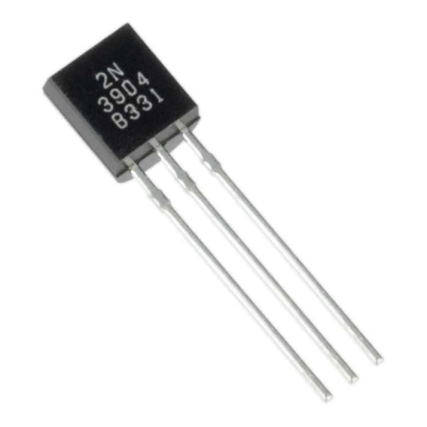

Choosing the components
Need a development board that can connect to WiFi
Raspberry pi
Photon
Electronic switches that can be controlled by the board
Relays
Transistors

